Slide 1
1
INHERITANCE

Slide 2
C++ Programming: From Problem Analysis to Program Design, Fourth Edition
1
Inheritance
Inheritance is an “is-a” relationship
Example: “every employee is a person”
Inheritance lets us create new classes from existing classes
New classes are called the derived classes
Existing classes are called the base classes
Derived classes inherit the properties of the base classes

Slide 3
Examples
Base class
Student
Shape
Employee
Derived classes
Graduate Student
Undergraduate student
Circle
Rectangle
Faculty Member
Staff member

Slide 4
C++ Programming: From Problem Analysis to Program Design, Fourth Edition
3
Inheritance (continued)
Inheritance can be viewed as a tree-like, or hierarchical, structure wherein a base class is shown with its derived classes

Slide 5
Inheritance (continued)
Single inheritance: derived class has a single base class
Ex. Circle class from Shape class
Multiple inheritance: derived class has more than one base class…will not be discussed in this chapter.
Ex. Son class from Mother class and Father class
Public inheritance: all public members of base class are inherited as public members by derived class

Slide 6
refercence: www.netacad.com
Defining a simple subclass (1)
We can use each class as a base (or a foundation) to define or build another class (a subclass). It’s also possible to use more than one class to define a subclass. You can see both of these cases on the right →
Note that the arrows always point to the superclass(es).
The left diagram illustrates a “single inheritance”, and the right one a “multiple inheritance” or “multi-inheritance”.
We’ll show you some examples of both types of inheritance.
We can also write about super classes as base classes, and subclasses as derived classes.

Slide 7
refercence: www.netacad.com

Slide 8
refercence: www.netacad.com
Defining a simple subclass (2)
The class on the right → will serve as a superclass. Analyse its structure – it’s not difficult, we promise.
The program emits the following text:
101

Slide 9
C++ Programming: From Problem Analysis to Program Design, Fourth Edition
8
Inheritance (continued)
General syntax of a derived class:
Where memberAccessSpecifier is public, protected, or private (default)
The private members of a base class are private to the derived class
Derived class cannot directly access them
Ex. Class SonClass: public FatherClass
{ };

Slide 10
refercence: www.netacad.com
Defining a simple subclass (3)
If we want to define a class named Y as a subclass of a superclass named X, we use the following syntax →
The difference from the notation we used before is in the fact that we have to:
place a colon after the subclass class name
optionally place a so-called visibility specifier (we’ll return to this soon)
add a superclass name
If there’s more than one superclass, we have to enlist them all using commas as separators, like this:
class A : X, Y, Z { … };
Let’s start with the simplest possible case.

Slide 11
refercence: www.netacad.com
Defining a simple subclass (4)
Take a look here → We’ve defined a class named Sub, which is a subclass of a class named Super. We may also say that the Sub class is derived from the Super class.
The Sub class introduces neither new variables nor new functions. Does this mean that any object of the Subclass inherits all the traits of the Super class, being in fact a copy of the Super class’s objects?
No. It doesn’t.

Slide 12
refercence: www.netacad.com
Defining a simple subclass (4) cont’d
If we compile the following code, we’ll get nothing but compilation errors saying that the put and get methods are inaccessible. Why?
When we omit the visibility specifier, the compiler assumes that we’re going to apply a “private inheritance”. This means that all public superclass components turn into private access, and private superclass components won't be accessible at all. It consequently means that you’re not allowed to use the latter inside the subclass.
This is exactly what we want now.

Slide 13
refercence: www.netacad.com
Defining a simple subclass (4) cont’d
We have to tell the compiler that we want to preserve the previously used access policy. We do this by using a “public” visibility specifier:
class Sub : public Super { };
Don’t be misled: this doesn’t mean that the private components of the Superclass (like the storagevariable) will magically turn into public ones. Private components will remain private, public components will remain public.

Slide 14
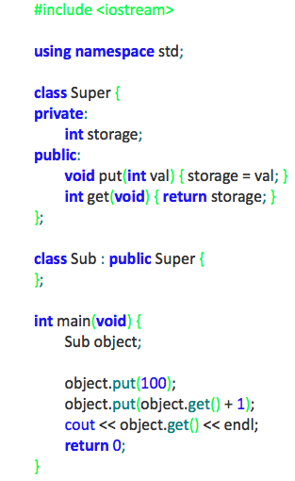
refercence: www.netacad.com
Defining a simple subclass (5)
Objects of the Sub class may do almost the same things as their older siblings created from the Superclass. We use the word ‘almost’ because being a subclass also means that the class has lost access to the private components of the superclass. We cannot write a member function of the Sub class which would be able to directly manipulate the storage variable.

Slide 15
refercence: www.netacad.com
Defining a simple subclass (5) cont’d
This is a very serious restriction. Is there any workaround?
Yes.
There’s the third access level we haven’t mentioned yet. It’s called “protected”.
The keyword protected means that any component marked with it behaves like a public component when used by any of the subclasses and looks like a private component to the rest of the world.
We should add that this is true only for publicly inherited classes (like the Super class in our example previous example)
Let’s make use of the keyword right now.

Slide 16
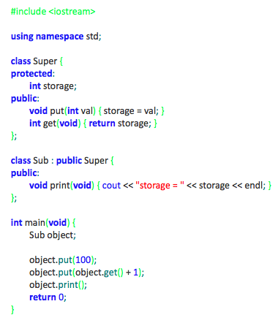
refercence: www.netacad.com
Defining a simple subclass (6)
As you can see in the example code → we’ve added some new functionality to the Sub class.
We’ve added the print function. It isn’t especially sophisticated, but it does one important thing: it accesses the storage variable from the Superclass. This wouldn’t be possible if the variable was declared as private.
In the main function scope, the variable remains hidden anyway. You mustn’t write anything like this:
object.storage = 0;
The compiler will be very stubborn about this.
We almost forgot to mention that our new program will produce the following output:
storage = 101

Slide 17
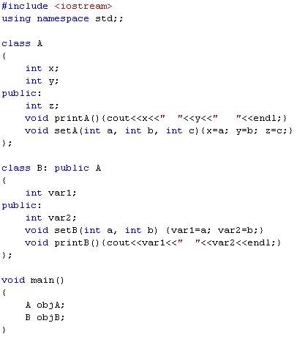
x
objA
Base
y
z
printA
setA
objB
var1
derived
var2
printB
setB
A
x
y
z
printA
setA

Slide 18
x
objA
y
z
printA
setA
objB
var1
Can not access x, y
var2
z
x
y
printB
setB
printA
setA

Slide 19
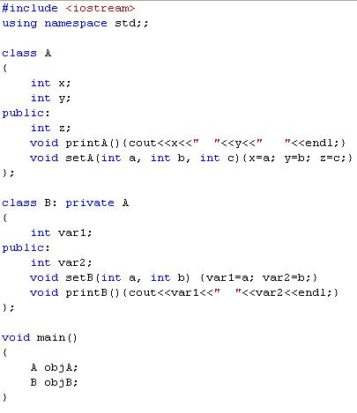
x
objA
y
z
printA
setA
var1
objB
var2
z
x
y
printB
setB
printA
setA

Slide 20
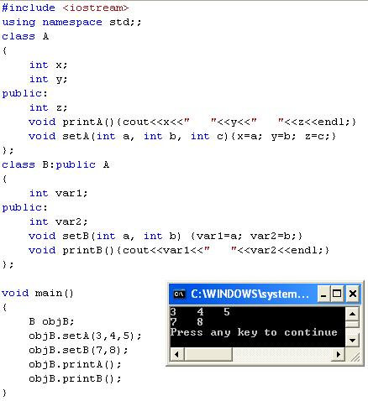
objB
var1
var2
z
x
y
printB
setB
printA
setA

Slide 21
refercence: www.netacad.com
Defining a simple subclass (7)
Now’s a good opportunity to do a little summarising here. We know that any component of the class may be declared as:
public
private
Protected
These three keywords may also be used in a completely different context to specify the visibility inheritance model. So far, we’ve talked about public and private keywords used in such a case. It should be no surprise to you that the protected keyword can be employed in this role, too.

Slide 22
C++ Programming: From Problem Analysis to Program Design, Fourth Edition
<number>
Inheritance (continued)
public members of base class can be inherited as public or private members
The derived class can include additional members--data and/or functions
The derived class can redefine the public member functions of the base class
All members of the base class are also member variables of the derived class

Slide 23
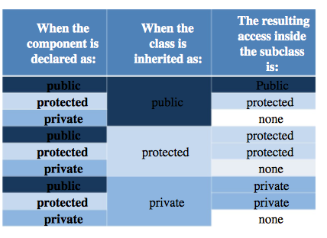
refercence: www.netacad.com
Defining a simple subclass (7) cont’d
Take a look at the table here →
It gathers all of the possible combinations of the component declaration and inheritance model, presenting the resulting access to the components when the subclass is completely defined.
It reads in the following way (take a look at the first row): if a component is declared as public and its class is inherited as public, the resulting access is public.
Familiarize yourself with the table – it’s a basic tool to resolve all the issues regarding the inheritance of the class components.

Slide 24
Redefining (Overriding) Member Functions of the Base Class
To redefine (override) a public member function of a base class
Corresponding function in the derived class must have the same name, number, and types of parameters. Redefined
If the function has a different signature, this would be function overloading.

Slide 25
Redefining (Overriding) Member Functions of the Base Class (continued)
If derived class overrides a public member function of the base class, then to call the base class function, specify:
Name of the base class
Scope resolution operator (::)
Function name with the appropriate parameter list

Slide 26
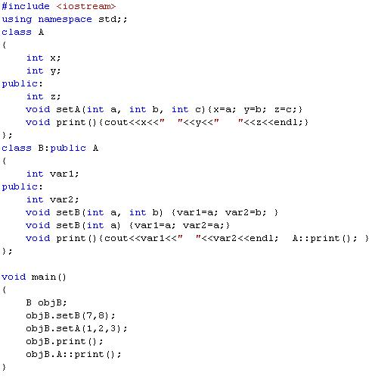
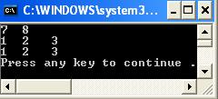
var1
var2
z
x
y
print
setB
A::print
setA

Slide 27
C++ Programming: From Problem Analysis to Program Design, Fourth Edition
<number>
Constructors of Derived and Base Classes
Derived class constructor cannot directly access private members of the base class
Derived class can directly initialize only public member variables of the base class
When a derived object is declared
It must execute one of the base class constructors
Call to base class constructor is specified in heading of derived class constructor definition

Slide 28
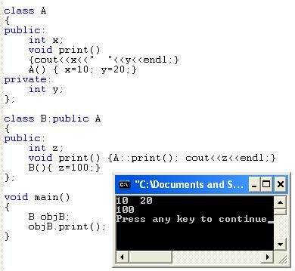
Example

Slide 29
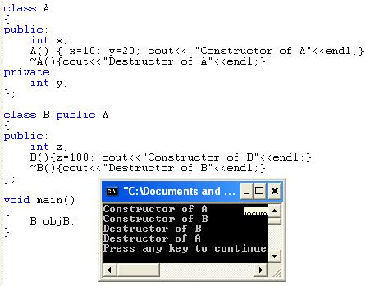
Example

Slide 30
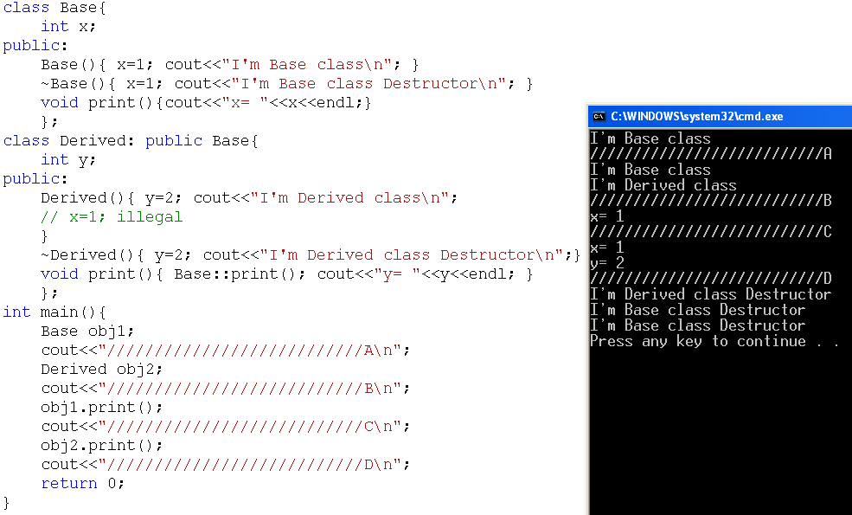
Example
C++ Programming: From Problem Analysis to Program Design, Third Edition
<number>

Slide 31
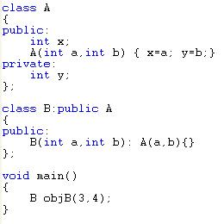
Initialization List and Inheritance
objB
A
3
x
4
y
Initialization list goes with constructor of derived class and uses class name to pass parameters to base class constructor.

Slide 32
C++ Programming: From Problem Analysis to Program Design, Fourth Edition
<number>
Protected Members of a Class
Private members of a class cannot be directly accessed outside the class
For a base class to give derived class access to a private member
Declare that member as protected
The accessibility of a protected member of a class is in between public and private
A derived class can directly access the protected member of the base class

Slide 33
C++ Programming: From Problem Analysis to Program Design, Fourth Edition
<number>
Inheritance as public, protected, or private
If memberAccessSpecifier is public:
public members of A are public members of B and can be directly accessed in class B
protected members of A are protected members of B and can be directly accessed by member functions (and friend functions) of B
private members of A are hidden in B and can be accessed by member functions of B through public or protected members of A

Slide 34
C++ Programming: From Problem Analysis to Program Design, Fourth Edition
<number>
Inheritance as public, protected, or private (continued)
If memberAccessSpecifier is protected:
public members of A are protected members of B and can be accessed by the member functions (and friend functions) of B
protected members of A are protected members of B and can be accessed by the member functions (and friend functions) of B
private members of A are hidden in B and can be accessed by member functions of B through public or protected members of A

Slide 35
C++ Programming: From Problem Analysis to Program Design, Fourth Edition
<number>
Inheritance as public, protected, or private (continued)
If memberAccessSpecifier is private:
public members of A are private members of B and can be accessed by member functions of B
protected members of A are private members of B and can be accessed by member functions (and friend functions) of B
private members of A are hidden in B and can be accessed by member functions of B through public/protected members of A

Slide 36
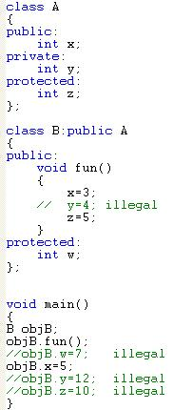
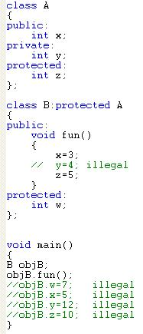
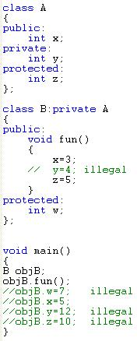

Slide 37
refercence: www.netacad.com
Multiple Inheritance
We’ll finish our current topic by demonstrating multi-inheritance. We need to emphasize that using this technique is commonly recognized as error-prone and obfuscating class hierarchy.
Any solution that avoids multi-inheritance is generally better and in fact many contemporary object programming languages don’t offer multi-inheritance at all. We think it’s a good argument to consider when you’re making design assumptions.

Slide 38

<number>
Multiple Inheritance (contd…)
class A
{
public:
A() { cout << "A's constructor called" << endl; }
};
class B
{
public:
B() { cout << "B's constructor called" << endl; }
};
class C: public B, public A // Note the order
{
public:
C() { cout << "C's constructor called" << endl; }
};
int main()
{
C c;
return 0;
}
Output

Slide 39
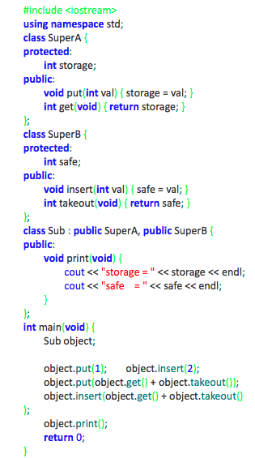
refercence: www.netacad.com
Multiple Inheritance - Ambiguity
This example should be clear (we hope).
The program will produce the following output:
storage = 3
safe = 5

Slide 40

<number>
Multiple Inheritance - Ambiguity
class SuperA
{
protected:
int storage;
public:
void put(int val){ storage = val; }
int get(){ return storage; }
};
class SuperB
{
protected:
int safe;
public:
void put(int val){ safe = val; }
int get(){ return safe; }
};
class Sub: public SuperB, public SuperA
{
public:
void print()
{
cout<<"Storage: "<<storage<<endl;
cout<<"Safe: "<<safe<<endl;
}
};
int main()
{
Sub s;
s.put(5); //Ambiguous call
//(call to SubA-put or SubB-put?)
cout<<s.get(); //Similar issue here
return 0;
}
Output: 5

Slide 41
<number>
Multiple Inheritance – Diamond Problem
The diamond problem occurs when two superclasses of a class have a common base class.
For example, in the following diagram, the TA class gets two copies of all attributes of Person class, this causes ambiguities

Slide 42

<number>
Multiple Inheritance – Diamond Problem
class Person {
// Data members of person
public:
Person(int x) { cout << "Person::Person(int ) called" << endl; }
};
class Faculty : public Person {
// data members of Faculty
public:
Faculty(int x):Person(x) {
cout<<"Faculty::Faculty(int ) called"<< endl;
}
};
class Student : public Person {
// data members of Student
public:
Student(int x):Person(x) {
cout<<"Student::Student(int ) called"<< endl;
}
};
class TA : public Faculty, public Student {
public:
TA(int x):Student(x), Faculty(x) {
cout<<"TA::TA(int ) called"<< endl;
}
};
int main() {
TA ta1(30);
}
Output

Slide 43


<number>
Diamond Problem – The Solution
class Person {
public:
Person(int x) { cout << "Person::Person(int ) called" << endl; }
Person() { cout << "Person::Person() called" << endl; }
};
class Faculty : virtual public Person {
public:
Faculty(int x):Person(x) {
cout<<"Faculty::Faculty(int ) called"<< endl;
}
};
class Student : virtual public Person {
public:
Student(int x):Person(x) {
cout<<"Student::Student(int ) called"<< endl;
}
};
class TA : public Faculty, public Student {
public:
TA(int x):Student(x), Faculty(x) {
cout<<"TA::TA(int ) called"<< endl;
}
};
int main() {
TA ta1(30);
}
Output

